Slide 1
Laura A. Janda
UiT The Arctic University of Norway
Verb classifiers –
not so exotic after all?
The case of Russian

Slide 2

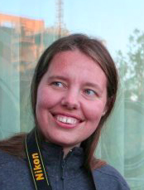

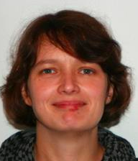
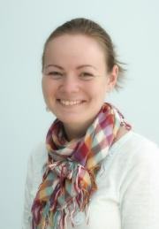


Collaborators
Anna
Endresen
Olga
Lyashevskaya
Tore
Nesset
Julia
Kuznetsova
Anastasia
Makarova
Stephen
Dickey
Svetlana
Sokolova

Slide 3
Overview
How it all started
Russian verbal prefixes: a crash course
Why “numeral classifiers” are really noun classifiers
Why Russian prefixes are verb classifiers
Further typological parallels

Slide 4
How it all started

Slide 5


Verb Classifier Systems
Linguists have only recently begun to describe verb classifier systems
Verb classifiers have been identified in Chinese and in several Australian languages (McGregor 2002, Gerner 2009)
McGregor (2002) on verb classification: “[d]oubtless it is not confined to the relatively few languages in which it has been hitherto described, though the extent of its distribution across the world’s languages remains to be charted.”

Slide 6
Russian verbal prefixes:
a crash course

Slide 7
Aspect in Russian
All forms of all verbs express aspect
(residue of biaspectual verbs are syncretic)
Perfective (marked)
Imperfective (unmarked)

Slide 8
Major Patterns of Russian aspectual morphology
Simplex verbs
nearly all Imperfective (delat’ ‘do’)
Prefixed verbs (prefix + simplex)
nearly all Perfective (s-delat’ ‘do’, pere-delat’ ‘redo’)
Prefixed and suffixed verbs (prefix + simplex + suffix)
secondary Imperfectives (pere-del-yva-t’ ‘redo’)

Slide 9
Major Patterns of Russian aspectual morphology
Simplex verbs
nearly all Imperfective (delat’ ‘do’)
Prefixed verbs (prefix + simplex)
nearly all Perfective (s-delat’ ‘do’, pere-delat’ ‘redo’)
Prefixed and suffixed verbs (prefix + simplex + suffix)
secondary Imperfectives (pere-del-yva-t’ ‘redo’)

Slide 10
Russian has 17 perfectivizing prefixes
Prefix | Prototypical path meaning | Related meanings
do‑ | reach | excess, add
iz‑ | out of a container | empty a container, exhaustive result, exhaust a surface, negative exhaustion, make out of, decline/deviate, acquire
na‑ | surface | accumulate
o(b)‑ | around | pass, overdo, mistake, affect many, affect a surface, envelop, impose/acquire a new feature
ot‑ | depart | bounce, unstick, remove, make non-functional, stop at the endpoint
pere‑ | transfer | superiority, overdo, redo, duration/overcome, bridge, turn over, mix, divide, seriatim, thorough
po‑ | set out | result, some, distribute
pod‑ | apply to bottom | horizontal approach, adjust, increment, secretly, minimal
pri‑ | arrive | attach, add, attenuate
pro‑ | through | thorough, duration, distance, pass
raz‑ | apart | crush, spread, swell, soften/dissolve, excitement, un‑
s‑ | down | together, once
u‑ | move away | move downwards, control, reduce, harm, perceive, place/fit, keep/save, cover completely, depart from norm
v‑ | into
v(o)z‑ | move upward | agitate, resist, rebuild
vy‑ | out of a container | empty a container, exhaustive result, exhaust a surface, negative exhaustion, create an image on a surface, make out of, decline/deviate, acquire, endure
za‑ | deflect | excess, begin, exchange, attachment, cover, fill, change to a fixed state

Slide 11
Prefixed verbs (prefix + simplex)
Natural Perfectives: have the “same” meaning as the simplex Imperfective
delat’ ‘do’ -> s-delat’ ‘do’
Specialized Perfectives: change the meaning of the simplex Imperfective
delat’ ‘do’ -> pere-delat’ ‘redo’
Complex Act Perfectives: indicate a certain amount of an activity
čitat’ ‘read’ -> po-čitat’ ‘read for a while’
Single Act Perfectives:
glupit’ ‘act stupid’ -> s-glupit’ ‘do one stupid thing’

Slide 12
Prefixed verbs (prefix + simplex)
Prefixes on Natural Perfectives termed “empty”
Natural Perfectives: have the “same” meaning as the simplex Imperfective
delat’ ‘do’ -> s-delat’ ‘do’
Specialized Perfectives: change the meaning of the simplex Imperfective
delat’ ‘do’ -> pere-delat’ ‘redo’
Complex Act Perfectives: indicate a certain amount of an activity
čitat’ ‘read’ -> po-čitat’ ‘read for a while’
Single Act Perfectives:
glupit’ ‘act stupid’ -> s-glupit’ ‘do one stupid thing’
Resultative uses are
SORTAL
classifiers
Procedural uses are
MENSURAL classifiers

Slide 13
Why “numeral classifiers” are nominal classifiers

Slide 14
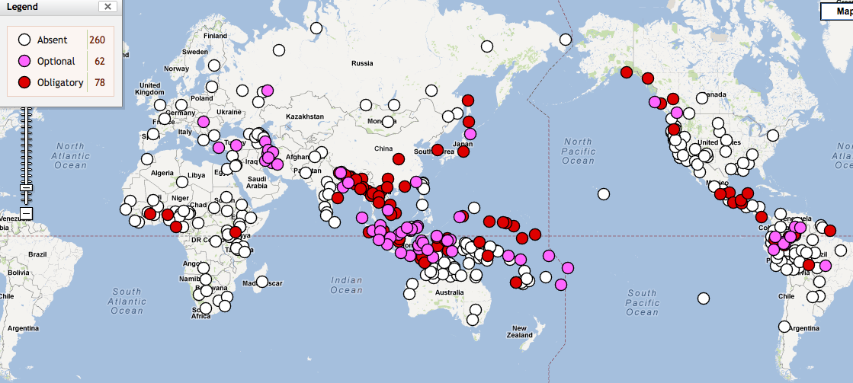
Numeral Classifier Systems Worldwide
Source: The World Atlas of Language Structures Online, wals.info

Slide 15
Functions of numeral classifiers
Numeral classifiers are noun classifiers
Numeral classifiers are “unitizers” that construe the referents of mass nouns as countable units, i.e., count nouns.
Sortal classifiers “sort” the nouns of the language into groups according to the units that the substances typically form, often according to their shape: long objects, flat objects, round objects, etc.
Mensural classifiers create non-inherent units of mass nouns by using measures: a bit, a cup, etc.

Slide 16

“Numeral” classifiers: obligatory in constructions with numerals, but used in other constructions too
1. liang tiao she
two CL snake
‘two snakes’
2. zhe tiao she
this CL snake
‘this snake’
3. zhe tiao
this CL
‘this’
Example from Xueyi Yao

Slide 17
Yucatec Maya numeral classifiers (Lucy 2000: 329)
‘un-tz’íit kib’ | [one long-thin wax] | ‘one candle’
‘un-tz’íit che’ | [one long-thin wood] | ‘one stick’
‘un-tz’íit nal | [one long-thin corn] | ‘one ear of corn’
‘un-tz’íit há’as | [one long-thin banana] | ‘one fruit of the banana’
‘un-wáal há’as | [one flat banana] | ‘one banana leaf’
‘un-kúul há’as ‘um-p’íit há’as | [one planted banana] [one bit banana] | ‘one banana tree’ ‘a little bit of banana’
SORTAL
classifiers
MENSURAL classifier
Notes:
Linguists at first misunderstood this system. They thought that kib’ meant candle, since that is what it usually means. Then they thought that tz’íit long-thin was an empty, purely formal marker, since candles are long and thin. What linguists did not appreciate at first was that kib’ doesn’t mean candle, it means wax!
And kib’ is representative of Yucatec Maya nouns in general, because nouns in this language refer to substances. From the perspective of Yucatec Maya, the world is an array of substances. The role of classifiers like tz’íit and wáal is to specify various possible units of substances when necessary, like when counting. It is as if the count nouns in English disappeared and were replaced with mass nouns.

Slide 18

One noun may combine with various classifiers
Burmese myiʔ ‘river’ (Becker 1975)
a. myiʔ tǝ myiʔ
river one cl:river
‘a river [default case]’
b. myiʔ tǝ yaʔ
river one cl:place
‘a river as site [for a picnic, etc.]’
c. myiʔ tǝ tan
river one cl:line
‘a river [on a map]’
d. myiʔ tǝ hmwa
river one cl:section
‘a river section [for fishing, etc.]’
e. myiʔ tǝ 'sin
river one cl:distant arc
‘a river as path to the sea’
f. myiʔ tǝ θwe
river one cl:connection
‘a river as a connection [linking villages]’
g. myiʔ tǝ ‘pa
river one cl:sacred object
‘a river [in mythology]’
h. myiʔ tǝ khu’
river one cl:conceptual unit
‘a river [in a discussion of rivers in general]’

Slide 19
One classifier may have various functions
HIGH semantic overlap between classifier and noun => default classifier
LOW semantic overlap between classifier and noun => other classifier
Mandarin Chinese classifier pian expresses flatness (Zhang 2013: 42):
a. san pian shuye (sortal classifier)
three cl:slice leaf
‘three leaves’
b. yi pian qiche (mensural classifier)
one cl:slice car
‘one group of cars’
c. san pian mutou (mensural classifier)
three cl:slice wood
‘three pieces of wood’
d. she pian luobo (mensural classifier)
ten cl:slice carrot
‘ten slices of carrot’

Slide 20
Why Russian prefixes are verb classifiers

Slide 21
Russian Prefixes are Verb Classifiers
Russian prefixes -- “unitizers”, designate discrete events
Russian prefixes -- quantification by perfective aspect
Resultative uses “sort” the verbs, classification by outcome:
SWELL with raz- as in puxnut’ > ras-puxnut’ ‘swell’
MOVE AWAY with u- as in krast’ > u-krast’ ‘steal’
ATTACH with pri- as in lipnut’ > pri-lipnut’ ‘get stuck to’
Procedural uses create non-inherent units:
SOME with po- as in sidet’ > po-sidet’ ‘sit for a while’
THROUGH with pro- as in plakat’ > pro-plakat’ (vsju noč’) ‘cry all through the night’
SORTAL
classifiers
MENSURAL classifiers

Slide 22
How prefixes sort verbs in Russian:
1429 simplex verbs
form 1981 Natural Perfectives
using 16 prefixes
Distribution of prefixes in Russian Natural Perfectives

Slide 23
Noun Classifiers vs. Aspectual Prefixes
 | Nouns | Verbs
Unitizer Type: | Numeral Classifier | Aspectual Prefix
Quantification: | Associated with numerals | Associated with Perfective Aspect
Spatial Profile: | Bounded/shaped region in space | Trajector-Landmark relation
Etymological Source: | Stem from nouns | Stem from prepositions/particles

Slide 24

One verb may combine with various prefixes
Russian:
pisat’ ‘write’
> na-pisat’ ‘write’ Natural Perfective
>> v-pisat’ ‘write in, insert’ Specialized Perfective
>> za-pisat’ ‘record, register’ Specialized Perfective
Czech:
psát
> na-psat
>> ve-psat
>> za-psat
Polish:
pisać
> na-pisać
>> w-pisać
>> za-pisać
BCS:
pisati
> na-pisati
>> u-pisati
>> za-pisati
Bulgarian:
piša
> na-piša
>> v-piša
>> za-piša
Late Common Slavic:
pьsati
> na-pьsati
>> vъ-pьsati
>> za-pьsati

Slide 25
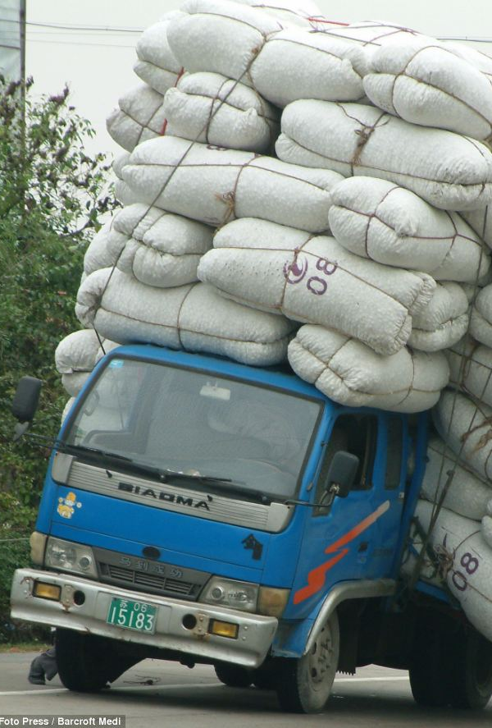
Russian gruzit’ ‘load’: 3 Natural Perfectives
na-gruzit’ ‘SURFACE-load’ focuses on accumulation of loaded objects, e.g., na-gruzit’ sumku arbatskim porodistym tovarom ‘load a bag with fine goods from the Arbat’
po-gruzit’ ‘RESULT-load’ most neutral, can be used for things that don’t ordinarily get loaded, e.g., po-gruzit’ ranennyx v furgon ‘load the wounded into a van’.
za-gruzit’ ‘FILL-load’ focuses on states resulting from loading, e.g. za-gruzit’ paroxod proviziej ‘load a steamship with provisions’; default in professional contexts.

Slide 26
One prefix may have various functions
Natural Perfectives
puxnut’ ‘swell’ > ras-puxnut’ ‘swell’
krast’ ‘steal’ > u-krast’ ‘steal’
lipnut’ ‘stick’ > pri-lipnut’ ‘stick’
nočevat’ ‘spend the night’ > pere- nočevat’ ‘spend the night’
HIGH DEGREE OF OVERLAP:
Natural Perfectives only change the aspect
Specialized Perfectives
dut’ ‘blow’ >> raz-dut’ ‘inflate’
bežat’ ‘run’ >> u-bežat’ ‘run away’
vjazat’ ‘tie’ >> pri-vjazat’ ‘tie onto’
ždat’ ‘wait’ >> pere-ždat’ ‘wait through something’
LOW DEGREE OF OVERLAP:
Specialized Perfectives change the aspect and the meaning

Slide 27
Natural vs. Specialized Perfectives
There is no crisp division between Natural Perfectives and Specialized Perfectives
Natural Perfectives are the perfectives for which the meaning of the base verb and the meaning of the prefix overlap most -- the combinations that are the “best match”
Natural Perfectives are also the most frequent -- on average 10x more frequent than Specialized Perfectives
Natural Perfectives
raz-gryzt’ ‘gnaw’
raz-bit’ ‘break’
raz-rezat’ ‘slice’
ras-seč’ ‘cut in two’
ras-pilit’ ‘saw in two’
ras-kusit’ ‘bite in two’
ras-tolkat’ ‘push apart’
raz-metat’ ‘sweep apart, scatter’
Dictionaries tend
to draw the line here
Specialized Perfectives

Slide 28
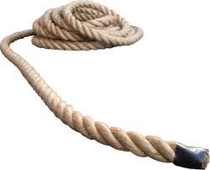

Sortal vs. Mensural Classifiers
The Numeral Classifier Construction in Mandarin Chinese
Classifier Type | Numeral | Classifier | Noun
Sortal | yi ‘one’ | tiao cl: long-thin | shengzi rope
Mensural | yi ‘one’ | bei cl: glass | pijiu beer
(Gao & Malt 2009)
Morpho-syntactic behavior is identical
Both types signal units
Sortal: refer to inherent units
Mensural: create units, individuate in terms of quantity
A single classifier can serve both sortal and mensural functions
General classifiers often serve both functions

Slide 29
Sortal & Mensural Classifiers for Nouns and Verbs
Unitizer Type: | NOUNS Numeral Classifier | VERBS Aspectual Prefix
Reference to inherent boundaries: | Sortal Classifiers | Lexical + purely perfectivizing prefixes (Natural Perfectives and Specialized Perfectives)
Imposition of external boundaries: | Mensural Classifiers | Procedural prefixes, a.k.a. Superlexical, Aktionsart prefixes (Complex Act Perfectives and Single Act Perfectives)

Slide 30
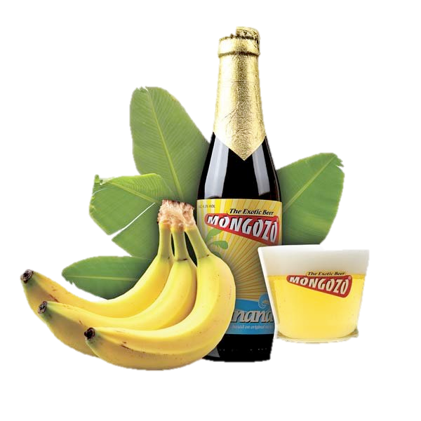

Procedural Prefixes as Mensural Classifiers
(1) a. yi bei pijiu (Mandarin Chinese: Gao and Malt 2009: 1129)
one cl:glass beer
‘a glass of beer’
(1) b. ’um- p’íit há’as (Yucatec Maya; Lucy 1992: 74)
a cl:little-bit/some banana
‘a little bit of/some banana’
(2) a. po- sidet’ (Russian)
SOME sit
‘sit for a while’

Slide 31
Russian Examples of Sortal and Mensural Classifiers
Type of Classifier | Russian Perfectivizing Prefixes | Russian Examples
(1) Individual Classifiers (Sortal) | Natural po-, s-, za-, etc. Specialized do-, s-, za-, etc. | po-stroit’ ‘build’, s-varit’ ‘cook’, za-krepit’ ‘fasten’ do-pisat’ finish writing’, so-brat’ ‘collect’, za-pisat’ ‘register’
(2) Collective Classifiers (Mensural) | Distributive pere-, po- Cumulative na- | pere-probovat’ ‘try a series of things’, po-brosat’ ‘throw a lot of things’ na-grešit’ ‘commit a lot of sins’
(3) Individuating Classifiers (Mensural) | Delimitative po- Perdurative pro- Attenuative pri-, pod- Ingressive za- Finitive ot- Intensive-Resultative do-…-sja, za-…-sja, etc. | po-sidet’ ‘sit for a while’ pro-plakat’ ‘cry all through a period of time’ pri-tormozit’ ‘tap the brake’, pod-soxnut’ ‘dry a little’ za-govorit’ ‘start to talk’ ot-služit’ ‘complete a tour of duty’ do-pljasat’sja ‘dance one’s feet off’, za-rabotat’sja ‘get lost in one’s work’
(4) Partitive Classifiers (Mensural) | Semelfactive s-, -nu- | s-glupit’ ‘do one stupid thing’, čix-nut’ ‘sneeze once’

Slide 32
Further typological parallels

Slide 33
Further typological parallels between noun classifiers and Russian prefixes
Structured polysemy
Foregrounding
Definiteness

Slide 34
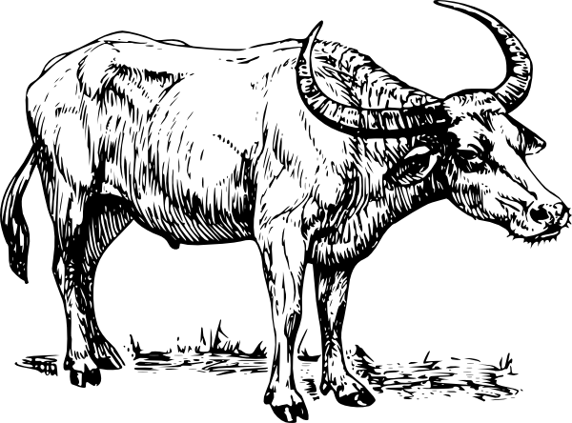
Structured polysemy of numeral classifiers
Radial category structure for
Thai Classifier tua
(Deepadung 1997)

Slide 35

Structured polysemy of Russian prefixes
Russian raz-
2. CRUSH
raz-davit’
‘crush’
7. UN-
raz-gruzit’
‘unload’
Prototype:
1. APART
raz-bit’
‘break apart’
3. SPREAD
raz-vetvit’sja
‘branch out’
4. SWELL
raz-dut’
‘inflate’
5. DISSOLVE
ras-tajat’
‘melt’
6. EXCITEMENT
ras-kalit’
‘make red-hot’

Slide 36

Foregrounding of numeral classifiers
Statistics from Mandarin Chinese (Sun 1988)
In narratives
80% of nouns referring to entities thematically important to narratives (subsequently mentioned) are introduced with a numeral classifier
18% of nouns referring to entities not thematically important to narratives (not subsequently mentioned) are introduced with a numeral classifier
See examples from myth about the giant Kuafu on next slides...

Slide 37
The giant Kuafu Example from Mandarin Chinese (Li 2000: 1121-1122)
Chuan shuo zai hen gu de shihou, you yi-ge jiao Youdu
Legend say be very old mod time, there-be one-cl called Youdu
de defang zhongnian bu jian taiyang, daochu yipian qihei.
mod place all year not see sun, everywhere all pitch dark
Zai nar you yi-zuo da hei shan, shan shang zhu
In there there-be one- cl big dark mountain mountain top live
zhe xuduo kepa de guaishou. Neixie guaishou jingchang xia
pf many scary mod monster. Those monsters often descend
shan weihai renmen. You yi-ge juren jiao Kuafu, ta
mountain endanger people there-be one-cl giant named Kuafu, he
yong guaizhang he guaishou bodou le jiu tian jiu yie zhongyu
use cane with monster fight pf 9 day 9 night finally
ba ta da si le.
ba them beat dead pf
‘Once upon a time, in a place called Youdu, people lived
in darkness all year round. There was a big black mountain
where many terrible beasts lived. The beasts often went out
to harm people. There was a giant called Kuafu. He fought
with the beasts with a stick for nine days and nine nights.
Finally, he killed them all...’

Slide 38
Foregrounding vs. backgrounding More Examples from Mandarin Chinese (Li 2000: 1122)
a. Kuafu si le. Tade guanzhang dunshi bian cheng le
Kuafu die PF His walking stick immediately change into PF
yi-ke xianhua shenghai de da taoshu.
one-CL flowers blooming MOD big peach tree
‘Kuafu died. His walking stick immediately changed into a [CL] large peach tree with blooming flowers.’
b. Pangu si hou, tade zhiti bian cheng le shan.
Pangu die after his body change into PF mountain
‘After Pangu died, his body changed into a [Ø] mountain.’
Li: Mandarin Chinese numeral classifiers are employed to mark noun phrases
as salient for the purpose of “vivifying or intensifying the description without
[an] implication of significance in the thematic development of the narrative.”
Example (a) with a numeral classifier presents a relatively vivid image;
example (b) presents a rather flat image.

Slide 39
Foregrounding of Russian prefixes
Foregrounding is understood in terms of narrative sequencing via main plotline events
Prefixes are associated with perfective aspect, which tends to mark sequenced plotline events
Kogda na-čalas’ pervaja mirovaja vojna, vsja sem’ja u-exala v derevnju Pominovo v Tverskoj oblasti, na rodinu babuški. Dom, gde oni žili, stoit, kstati, do six por. Tam že, v Pominove, otec po-znakomilsja s moej mamoj. Oni po-ženilis’, kogda im bylo po 17 let.
‘When WWI began, the whole family went to the village of Pominovo in the Tver’ region, where my grandmother comes from. The house where they lived is still standing, by the way. It was there in Pominovo where my father met my mother. They got married when they were 17 years old.’

Slide 40
Definiteness of numeral classifiers
Bare classifier constructions (lacking numerals) signal specific or definite reference
Hmong example (Li & Bisang 2012: 353)
Thaum ub muaj ob tug niam txiv. Tus txiv tuag lawm.
Long.ago there.are two cl wife husband cl husband die pf
Tus niam quaj quaj nrhiav nrhiav tsis tau tus txiv.
cl wife cry cry look.for look.for neg get cl husband
‘Long ago there was a wife and a husband. The husband died.
The wife kept crying but no matter how she looked, she couldn’t find the/her husband.’
Vietnamese example (Simpson et al. 2011: 185-186)
Thư viện vừa có thêm một kế toán và một luật sư.
library just have add one accountant and one lawyer
Ngời kế toán rất chăm chỉ, nhưng ngời luật sư rất lười.
cl accountant very diligent but cl lawyer very lazy.
‘The library has a new accountant and a new lawyer. The accountant is hard-working, but the lawyer is quite lazy.’

Slide 41

Definiteness of Russian prefixes (Leinonen 1982, Dickey 2000)
a. Kto pro-čital Vojnu i mir? (Perfective, presumes an expectation)
b. Kto čital Vojnu i mir? (Imperfective)
‘Who read War and Peace?’
а. Ty pro-čital moju knigu? (Perfective)
b. Ty čital moju knigu? (Imperfective, follow up: Ty ne videl tam zapisku?)
‘Did you read my book? (You didn’t see a note there?)’
Perfective sentences reflect shared information, focus on specific event.
Imperfective sentences lack this implication.

Slide 42
Conclusions Verb Classifier Hypothesis
Prefixes that form Natural and Specialized Perfectives in Slavic languages parallel sortal numeral classifiers
Prefixes that form Procedural Perfectives in Slavic languages (mainly East Slavic and Bulgarian) parallel mensural numeral classifiers
Shared traits of numeral classifiers and Slavic aspectual prefixes
One noun/verb may combine with various classifiers
One classifier may have various functions combined with various nouns/verbs
Structured polysemy of classifiers
Foregrounding of classifiers
Definiteness of classifiers
Recognition of Slavic aspectual prefixes as verb classifiers facilitates typological comparison

Slide 43
For references, see:
Dickey, Stephen M., Laura A. Janda. 2015. “Slavic Aspectual Prefixes and Numeral Classifiers: Two Kinds of Lexico-Grammatical Unitizers”. Lingua 168, 57-84. DOI: 10.1016/j.lingua.2015.09.005
Janda, Laura A., Anna Endresen, Julia Kuznetsova, Olga Lyashevskaya, Anastasia Makarova, Tore Nesset, Svetlana Sokolova. 2013. Why Russian aspectual prefixes aren’t empty: prefixes as verb classifiers. Bloomington, IN: Slavica Publishers

